Slide 1





Other Report Arch
WCNP
Cluster: SCUS/WUS
Azure SQL
Cluster: SCUS/WUS
React Client
Other Report API
Future Scope: * Kafka Implementation for
Email Notifications
Cluster: SCUS/WUS

Slide 2
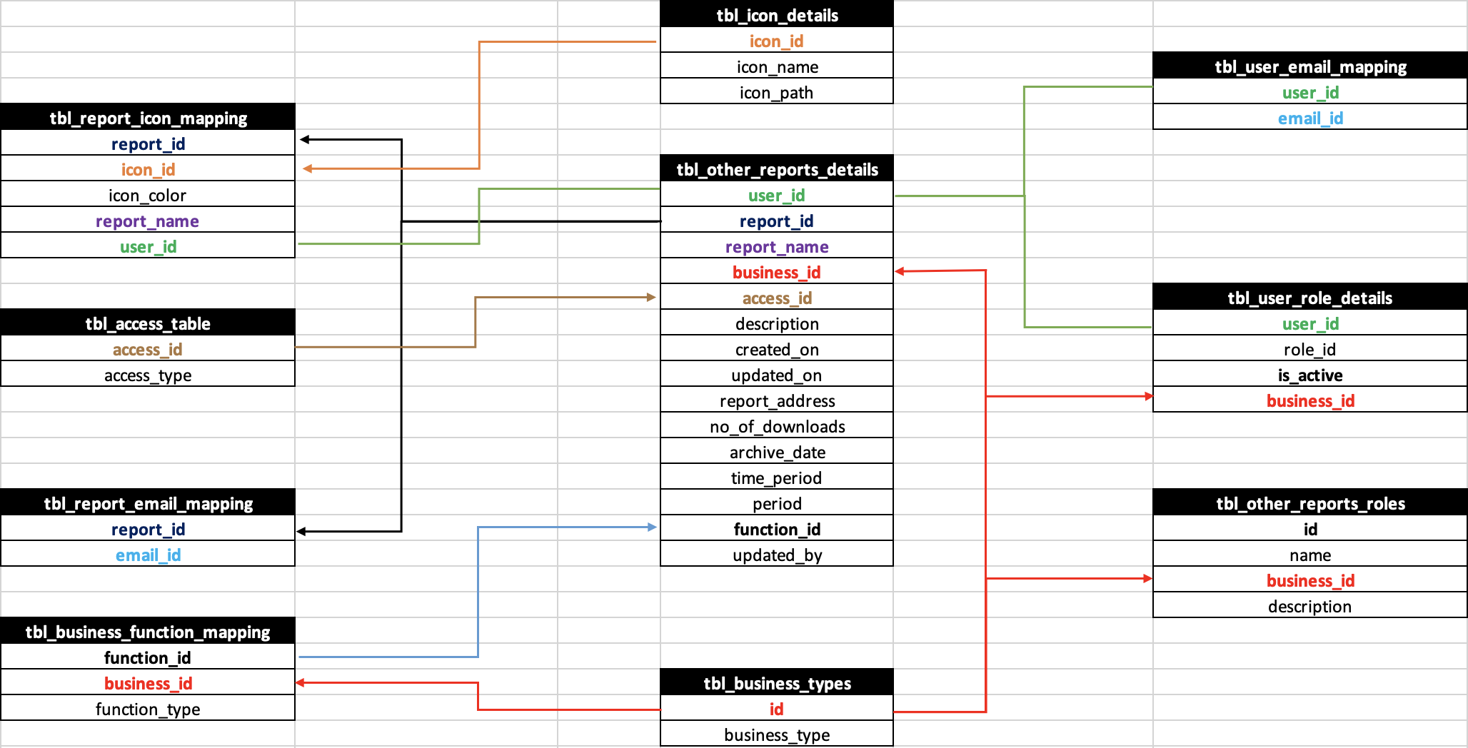

Slide 3
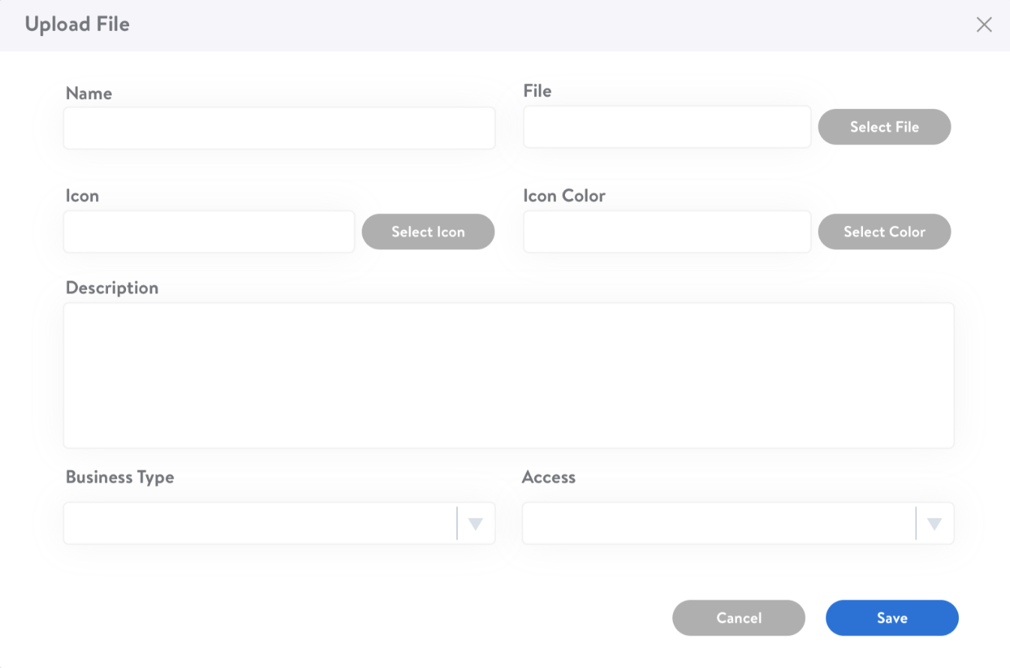
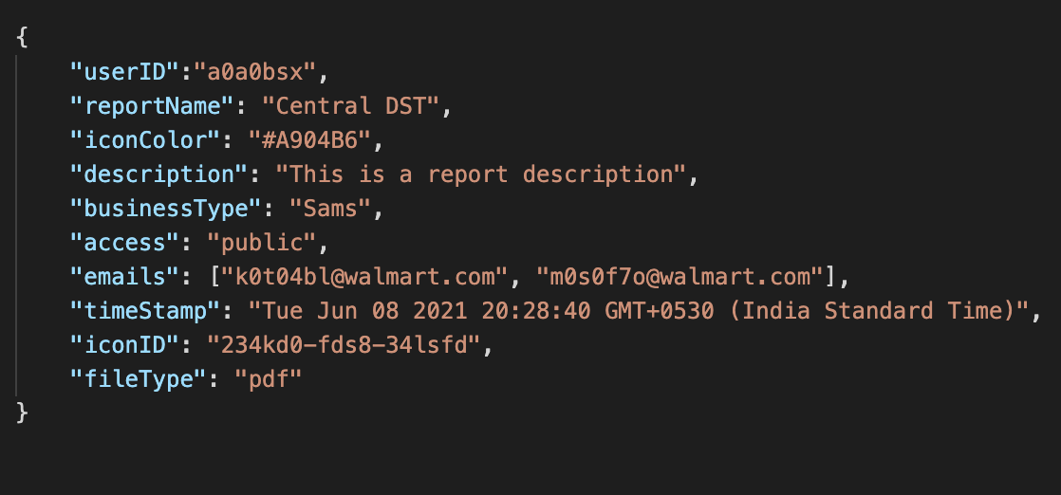
+
Report (PDF/Excel/PPT/Word)

Slide 4

RDBMS

Slide 5
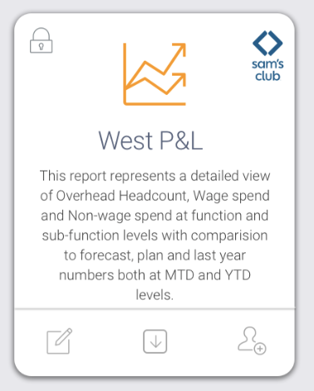

Slide 6
Owner
Can create/update/delete report under his businessTypes
Can see all reports under his businessType in "MyReports" Section of UI (either created by him/or other owners/other admins of same businessType )
Can add new admins via Sail Point
Can add new users also remove users to report under his businessType
Can view all reports shared with owner(but Not created by Owner) under "Shared With me" section of UI but only reports of businessType which the owner is having accessTo
Reports under "Shared With Me" cannot be edited but only downloadable at UI
Reports under MyReports section can be downloadable by Owner
Can archive any of the reports under his businessType(either created by him/or other owners/other
admins of same businessType )
Can restore any of the archived reports under his businessType
Normal User
Cannot see "MyReports" section of UI since he does not have permissions to create/edit/update report.
Can see all the reports shared with user under "Shared With me" section of UI but only reports of businessType which the Normal User is having accessTo
Reports under "Shared With Me" cannot be edited but only downloadable at UI
Reports under MyReports section can be downloadable by Normal User
Cannot archived or restore reports and cannot see archive tab
Admin
Can create/update/delete report under his businessType
Can see all reports which are only created by him only under his businessTypes in MyReports Section of UI.
Cannot add other admins
Can add new users also remove users to report under his businessType
Can view all reports shared with Admin(but Not created by Admin) under "Shared With me" section of UI but only reports of businessType which the Admin is having accessTo
Reports under "Shared With Me" cannot be edited but only downloadable at UI
Reports under MyReports section can be downloadable by Admin
Can archive only the reports created by Admin himself under his businessType(only created by him but not other admins or owners )
Can restore the archived reports under his businessType (only created by him but not other admins or owners )

Slide 7
Constraints
Unique_icon – To ensure icon_id and icon_color combination to be unique for each report
Unique_Report_Icon – To ensure report Name should be unique for combination of icon and icon color
Each report can have multiple users but the combination of report and user cannot be repetitive. So report_id and email_id combination is made unique in [irpc].[tbl_report_email_mapping] table
Each business can have multiple functionTypes but the combination of businessType and functionType should be unique.
Under each user businessType each user can have only one role
For example - Under Sams Club, user can have either Owner/Admin/Nomal User permission but not combination of them under this businessType.
But a user can have multiple roles of different businessType
For example - Owner of Sam’s Club and Admin of Enterprise.

